Slide 1
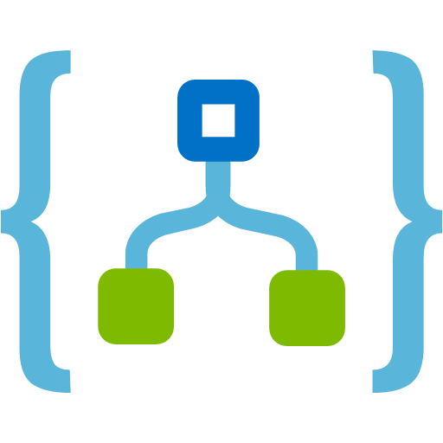
Logic Apps Overview
Umamaheswaran
@UMW1990 www.umamaheswaran.com

Slide 2

What I do?
DEVELOPER

Slide 3

What is Logic Apps?
I DON’T KNOW!

Slide 4





Azure App Service
WEB APPS
MOBILE APPS
LOGIC APPS
API APPS

Slide 5
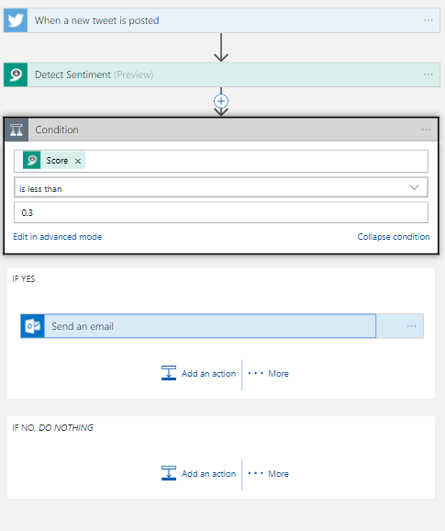
Logic Apps
Design workflows that start from a trigger and then executes a series of actions, each securely invoking an App Service, while handling authentication, “checkpointing” and durable execution.

Slide 6
Agenda
Logic App Concepts
Logic App Environment
Connectors
Triggers & Actions
Basic Scenarios
Advanced Scenarios
Hybrid Scenarios
Next Steps

Slide 7
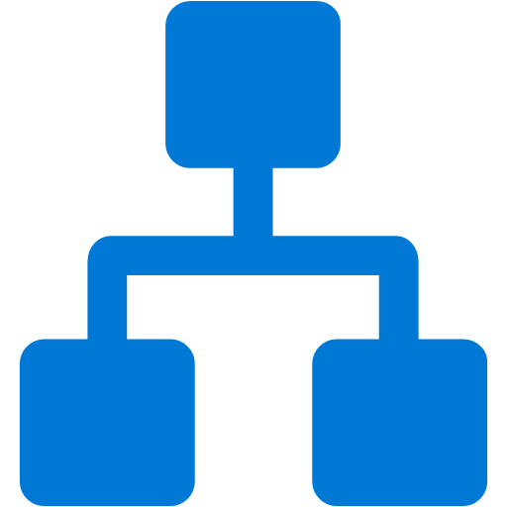




Logic App Concepts
Workflow
Connectors
Triggers
Actions
Enterprise Integration

Slide 8
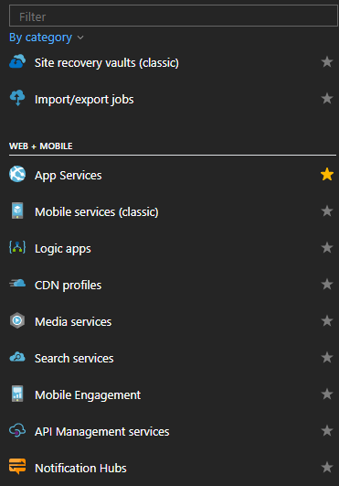
Logic App Environment
Logic Apps are part of the new “Web + Mobile” Suite
Logic App management is not available via the “Classic” portal
Create and manage Logic Apps in
Azure Management portal
Visual Studio

Slide 9
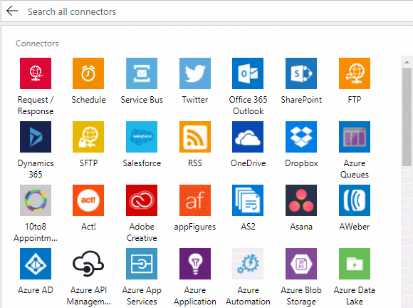
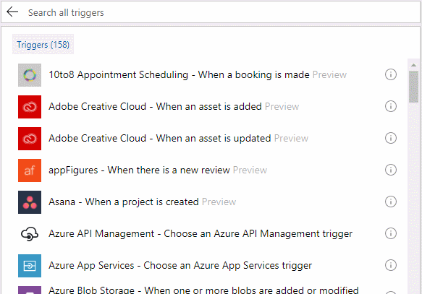
Built-in connectors

Slide 10
Trigger Types
Request
Makes the Logic app an endpoint
Recurrence
Fires based on a defined schedule
HTTP
Polls an HTTP web endpoint
ApiConnection
Polls like the HTTP trigger using the Microsoft managed APIs
HTTPWebhook
Opens an endpoint, similar to the manual trigger, however, it also calls out to a specified URL to register and unregister
ApiConnectionWebhook
Operates like the HTTPWebhook trigger using the Microsoft managed APIs

Slide 11
Standard Action Types
HTTP
Calls an HTTP web endpoint
ApiConnection
Similar to an HTTP action, but uses the Microsoft managed APIs
ApiConnectionWebhook
Similar to an HTTP Webhook, but uses the Microsoft managed APIs
Response
Defines a response for an incoming call
Wait
Waits a fixed amount of time or until a specific time
Workflow
A nested workflow

Slide 12
Collection Action Types
Scope
A logical grouping of other actions
Condition
Evaluates an expression and executes the corresponding result branch
Foreach
Will iterate over an array and perform inner actions for each item
Until
Will execute inner actions

Slide 13
DEMO Connectors, Triggers and Actions

Slide 14
Basic Scenarios
Perform recurring workflows, like checking a website or service
Listen for event from a service, like a new email, file, work item, or status update
Call an Azure function
Send an email or status update
Perform a search against a service

Slide 15
DEMO Basic Scenario

Slide 16
Advanced Scenarios
Listen for service status updates and send results or partial results to email
Listen for file uploads or content updates and trigger notifications
Copy or move new file from one location to another based on properties or metadata
Polling services or website and moving content to a storage queue or blob container
Automatically updating work item status
Automatically posting status updates with content from a function

Slide 17
DEMO Advanced Scenario

Slide 18
Hybrid Scenarios
Integrating supported connectors
Leveraging Azure function apps
Connecting to a notification hub
Starting and integration with default templates
Connecting to other Logic Apps as an Action
Publishing from Visual Studio 2015

Slide 19
DEMO Hybrid Scenario

Slide 20
Next Steps
Review and practice with the existing azure Logic app templates
Start migrating existing workflows to Azure Logic Apps
Start working with Azure Function Apps to create your own webhook functions
To integrate into your logic trees
Evaluate your Azure Resource Storage configurations

Slide 21


